Slide 1
Splunk 4 Good
Energy and Splunk
David Murdter Gregory Gunadi Alan Kwok

Slide 2



Executive Summary
Use Splunk to create an energy forecasting model
Objective
Method
Next Steps
Our objective was to create a predictive model using Splunk and its machine learning toolkit to improve energy consumption forecasts for Seattle
We split our methodology
into three different parts:
Find real-time and event-level dataset
Chose a location with one source of power and meteorological consistency
Use the set to train model and visualize
Similar models could be used throughout the United States, or in developing countries to help predict and prevent overconsumption of energy and reduce the number of blackouts

Slide 3




Creating an Objective
We wanted a solution that could be easily replicated and implemented
Broader Objectives
Broader Objectives
Demonstrate how Splunk could be used to monitor and forecast energy consumption
Highlight a unique use case facilitated by new features in Splunk like machine learning
Project Objective
Improve the day-ahead hourly energy demand forecast for the Seattle City Light power plant

Slide 4

Choosing a Data Set
We wanted to find data that was event-level, real-time, and accurate
Requirements to choosing our data set
Event-Level
Real-Time
Accurate
Provides a wealth of energy production and usage data across the United States, including hourly data
Energy Information Administration
Provides years of highly detailed hourly weather data for locations across the United States
Weather Underground

Slide 5
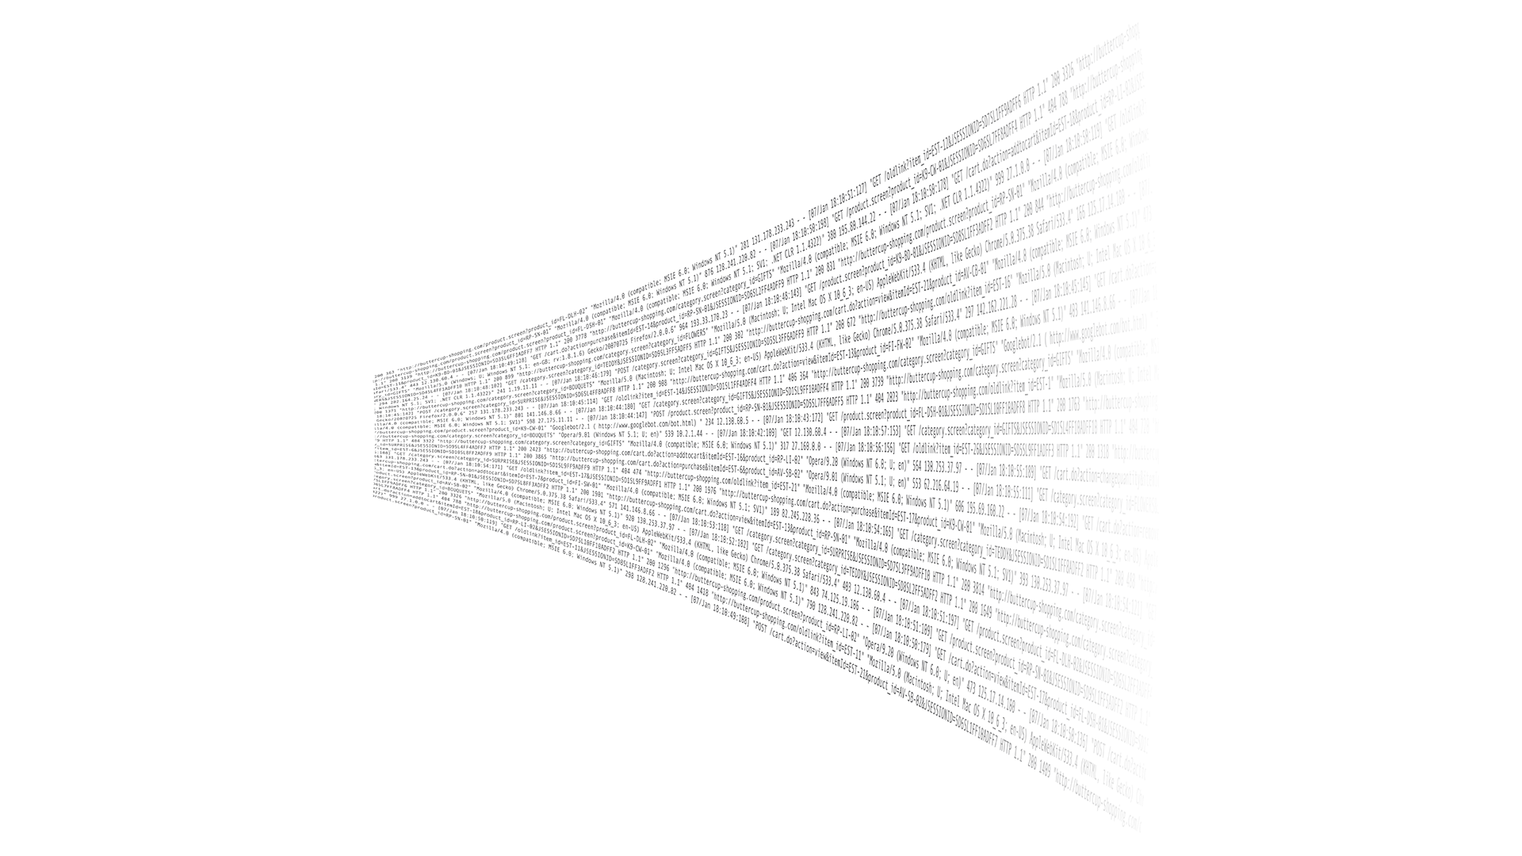

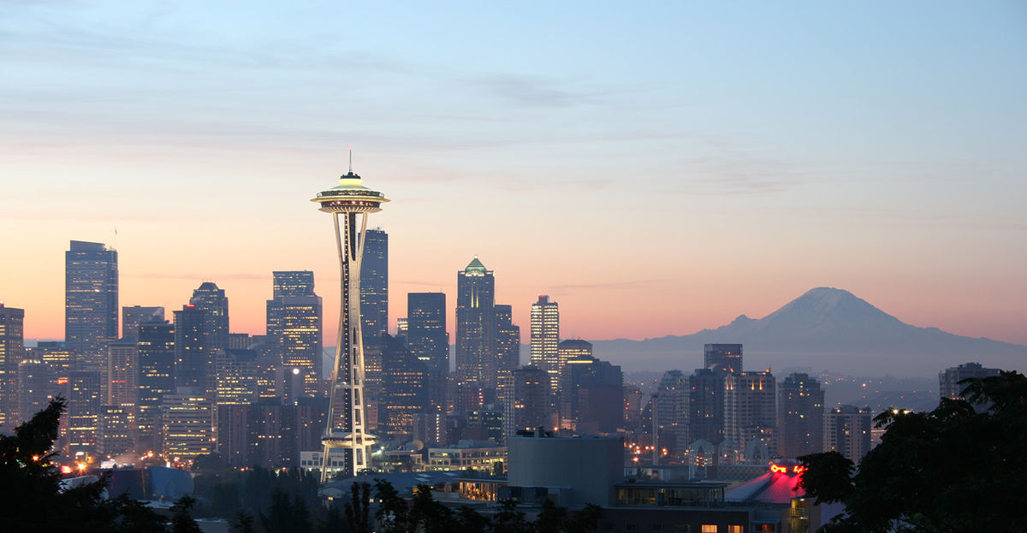
Choosing a Sample
We choose Seattle as a sample to train our data model on
Why Seattle?
The entire city is powered by a single power plant, which means the data set is consolidated
1
The city is geographically compact with no microclimates, thus allowing our data to be meteorologically consistent
2
Great data set to explore a strong correlation between weather and data consumption
3

Slide 6
Method
After gathering the data, we developed a three step plan to analyze it
EIA Import
Weather Import
Visualization
Model
First, we imported hourly consumption and forecast data using the EIA API
Third, we used Splunk to create visualizations of the different data sets
Then, we used a Python script to import historical weather data from Weather Underground’s API
Lastly, we used the Splunk Machine Learning Toolkit to develop a model for future energy consumption
1
2
3
4
Result:
Result: Created a data model that was able to predict with [Number]% accuracy

Slide 7


Results
Through our analysis, we were able to improve forecasting by ?%
Variables Introduced
Real-Time Weather Data
Splunk Machine Learning Toolkit
Potential Variables
The existing energy forecast available through the EIA had an accuracy rate of approximately X%
Anomaly Detection and other apps
The existing energy forecast available through the EIA had an accuracy rate of approximately X%
Real-Time Alerts

Slide 8




Next Steps
Splunk’s model can be used to improve electricity access for people around the world
To Monitor and Forecast
Splunk could be used to monitor and forecast energy usage around the world
In Developing Countries
Splunk could be deployed in developing countries to optimize energy usage as their infrastructure is not well-built
In the United States
Splunk could be used within the United States to ensure stability on an aging grid
In the Home
Splunk can be used in the home to prevent excessive energy usage

